Slide 1

Roku: Business Analytics Case Analysis
Selena (Yuzi Sun)

Slide 2

Agenda
Company Overview
Business Model and products
How Roku uses big data and analytics
Recommendations and looking forward

Slide 3
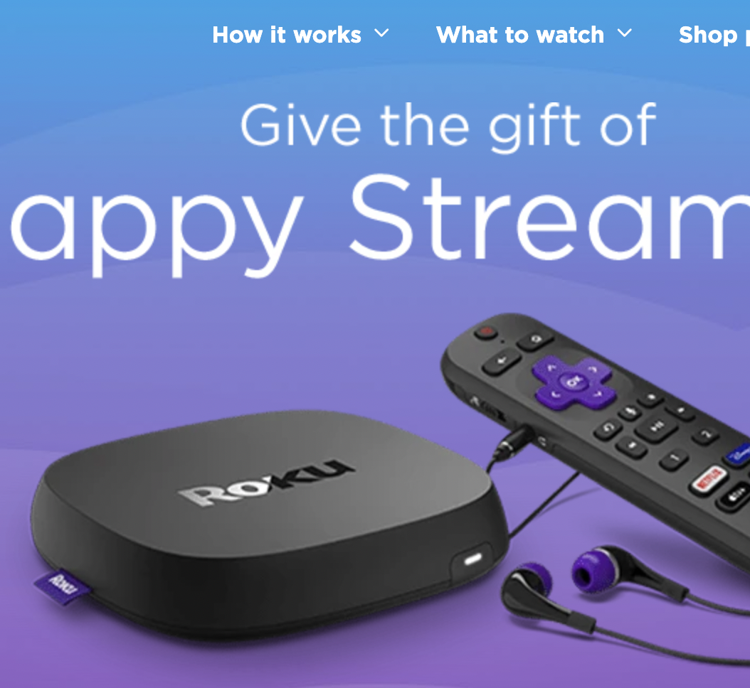
Company Overview
Founded in 2002
2021 Revenue: 2.765 B
Market Cap：11.25 B
Current Stock price: $82.7
Operating income：$241.4 Million
Total net revenue grew 55% year over year
Average Revenue per User(ARPU) grew to $41, 43% YoY

Slide 4
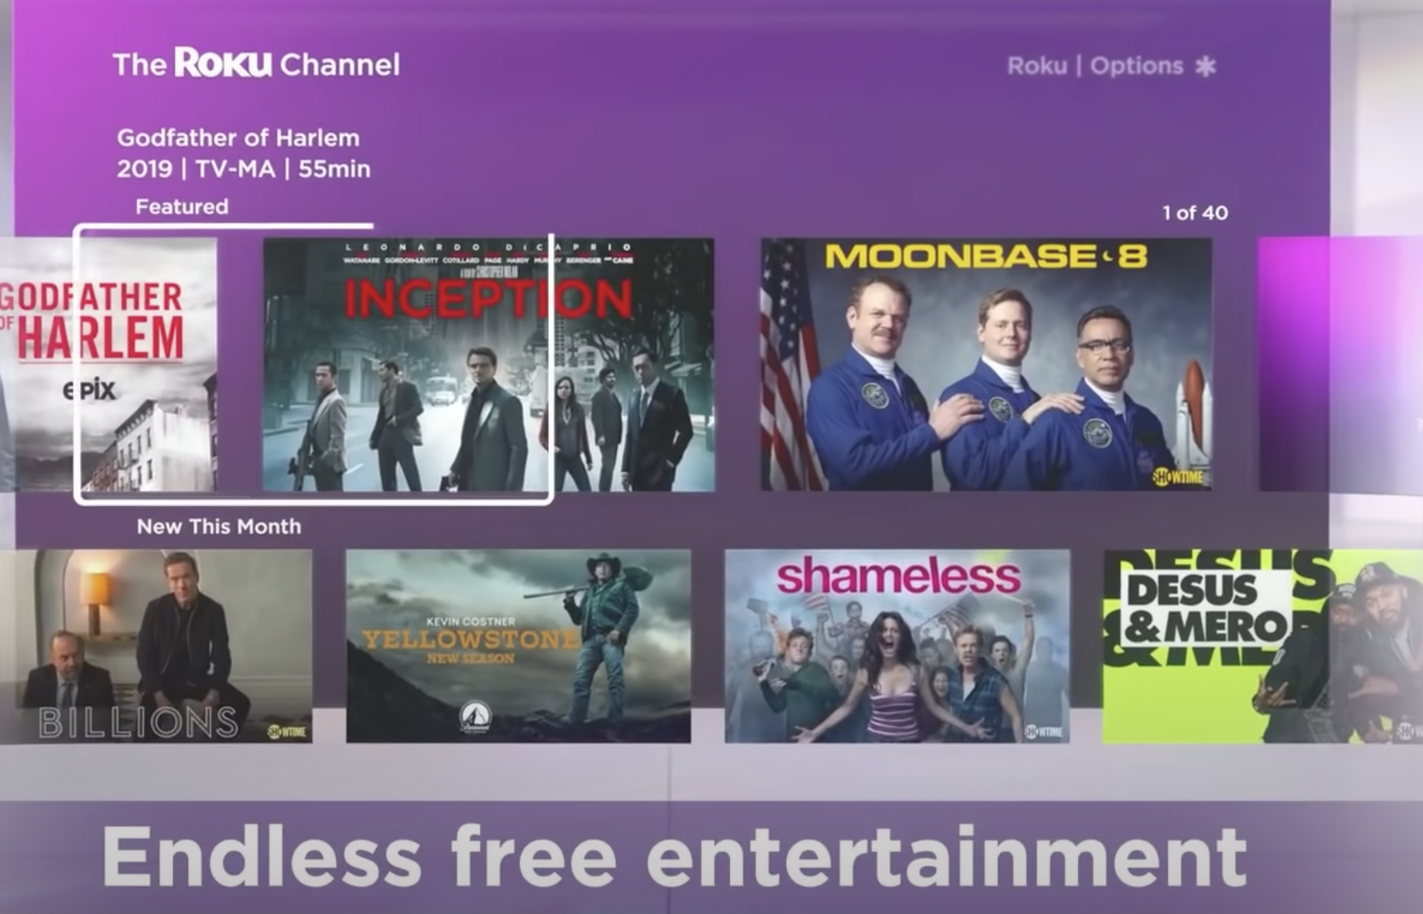
Business Model and Products
What business is Roku in: Hardware digital media players which offer streaming media content from online services; Advertising business; liscensing its hardware and operating system to businesses
Products: Roku Express, Roku Express+, Roku Ultra, Roku Streaming Stick, Roku TV, Roku OS
The first Roku model was developed in 2008, collaborating with Netflix

Slide 5
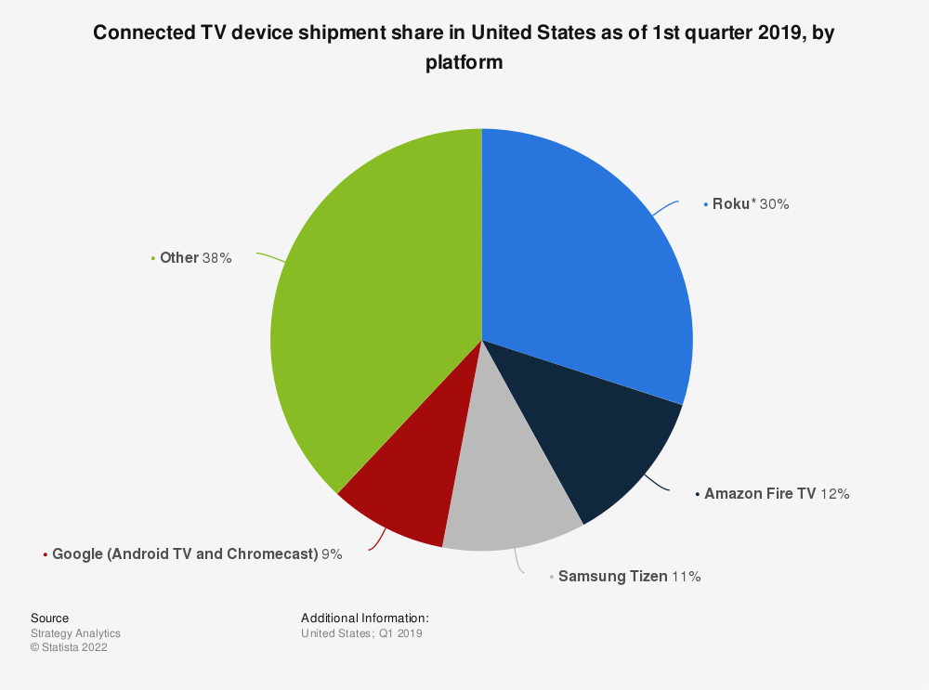
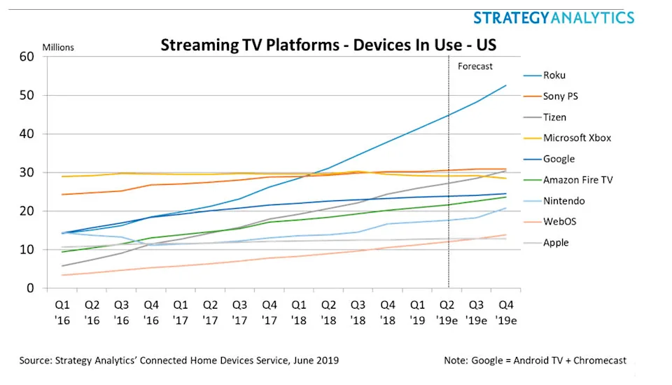
Roku’s Market Share in Streaming devices

Slide 6
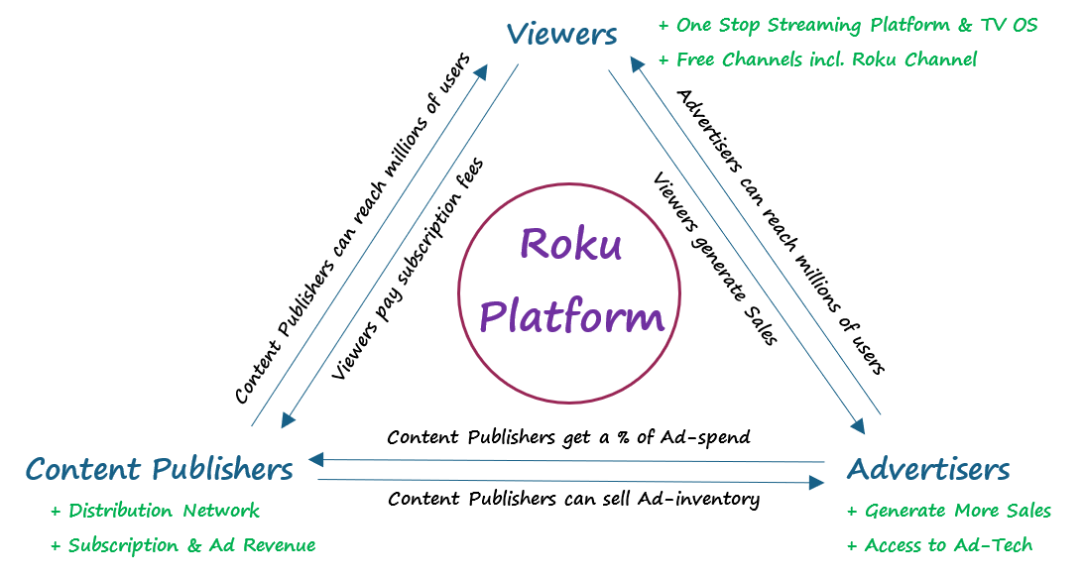
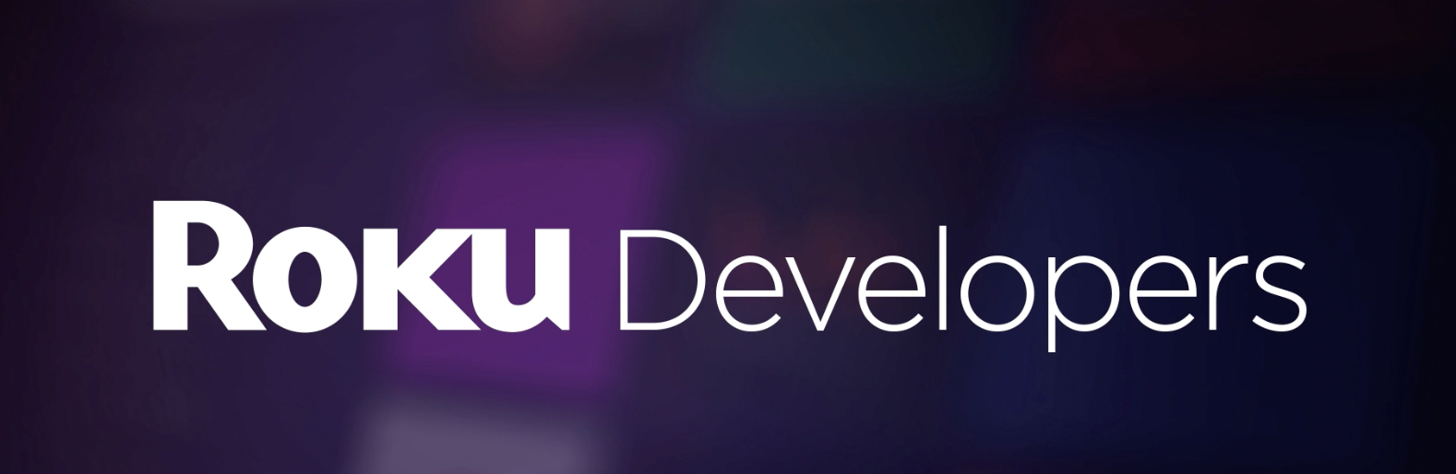
Roku’s business process flows and feedback approaches

Slide 7
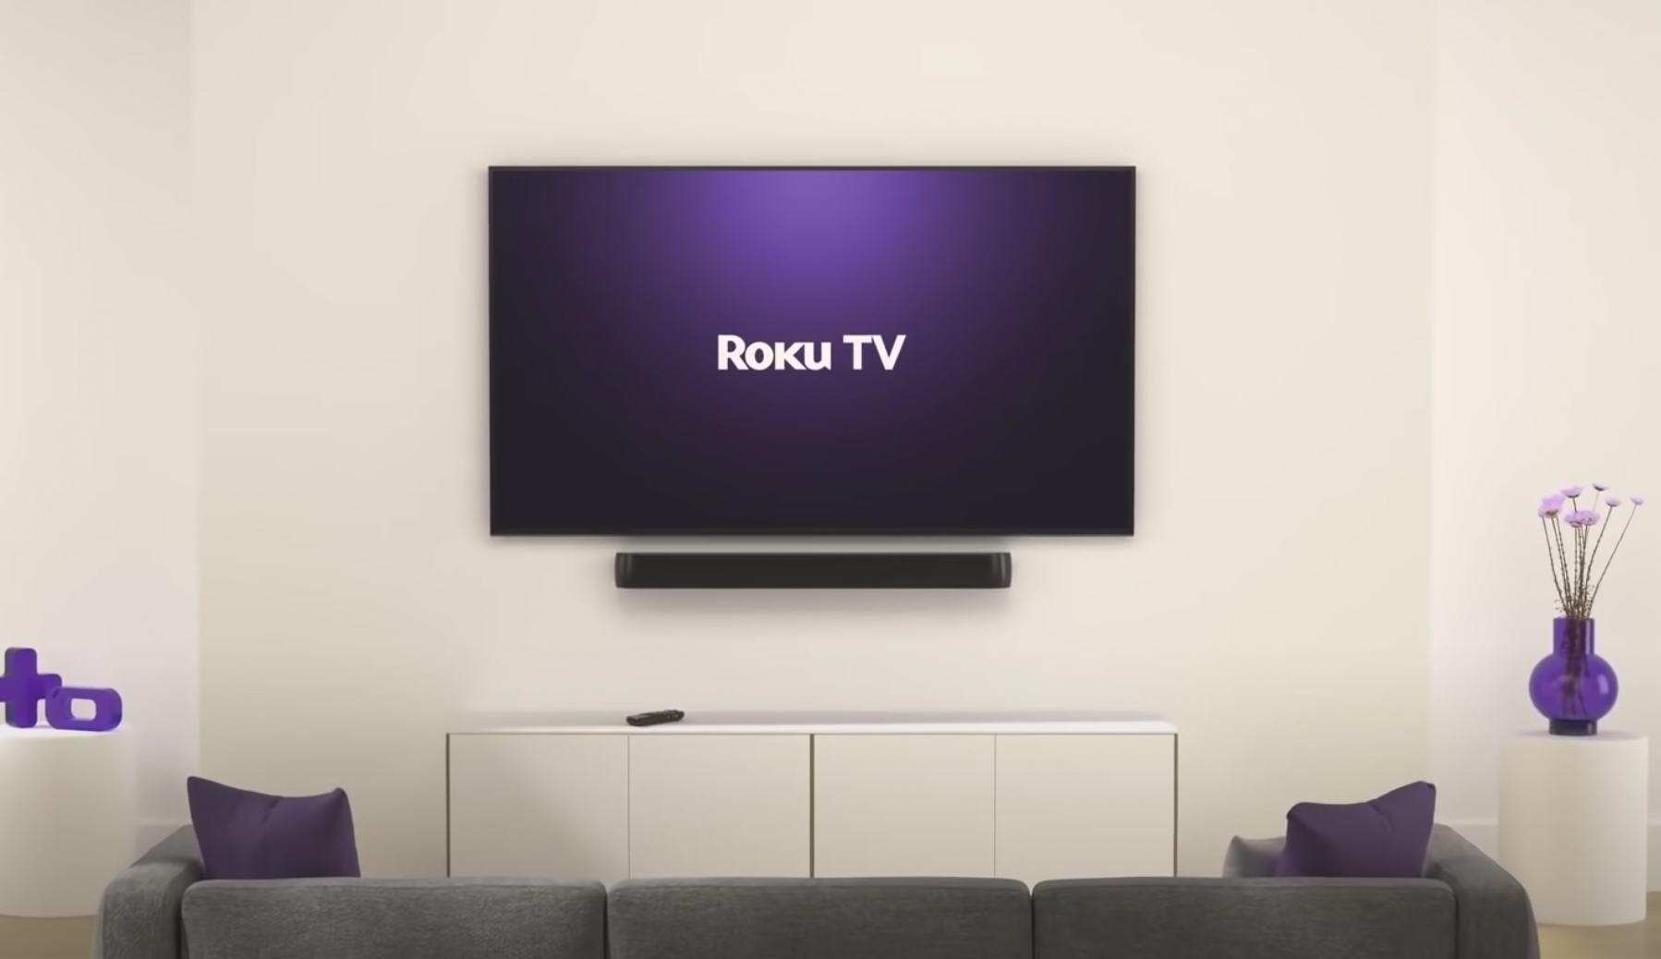
How Roku utilize data analytics?
Roku utilizes their huge amount of data from user registrations and streaming interactions to break audiences out into many different targeting segments for different kinds of ad campaigns
It uses machine learning to categorize users and content into certain groups and matches with only the most personalized and relevant ads
Roku has a data lead that only compounds as they keep winning clicks; this edge shows in the company’s financials and the bottom line of income statement

Slide 8
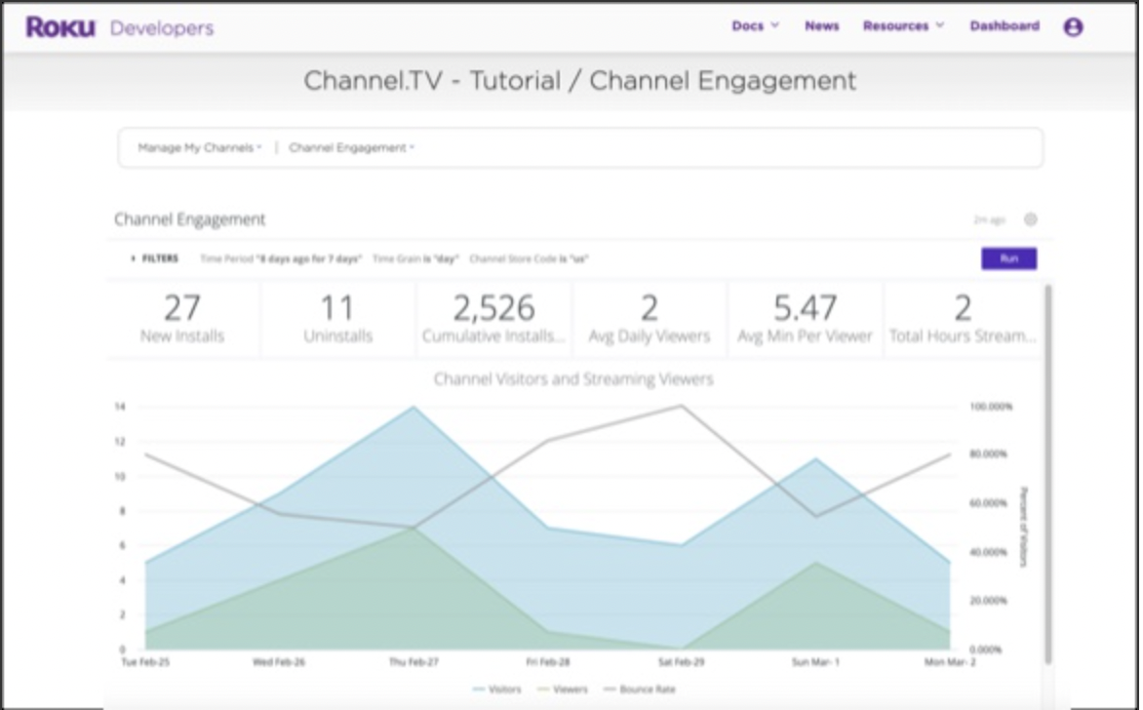
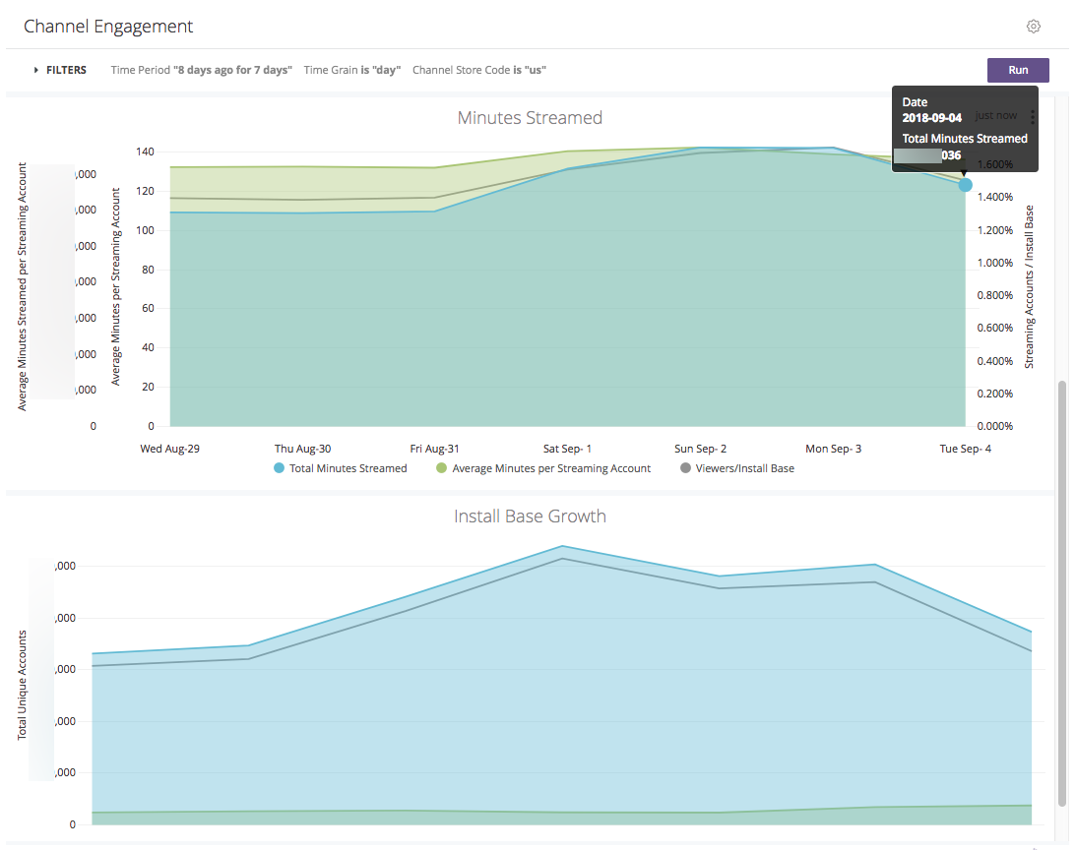
Roku Developers Data Analytics
Roku’s own analytics platforms for channel owners to get real-time data on their channel

Slide 9
Recommendations
Aggressively expanding on the international market to gain the first mover advantage and the economics of scale: this is a winner takes it all business
Currently most of Roku’s revenue comes from within the US; Just like how Netflix expanded rapidly globally, Roku should do the same to obtain the economics of scale and become the biggest industry leader
Continuously keeping the core business function of the data scientist team to gain the upper hand of the big data and machine learning

Slide 10
Citations
https://www.cnbc.com/2021/06/18/how-roku-dominated-streaming-anthony-woods-new-content-obsession.html
https://www.theverge.com/2019/10/11/20908128/smart-tv-surveillence-data-collection-home-roku-amazon-fire-princeton-study
https://www.youtube.com/watch?v=SAEdbjqhNOc&ab_channel=TickerSymbol%3AYOU
https://www.youtube.com/watch?v=6UCUQcLswKA&ab_channel=CommonSenseInvestor
https://finance.yahoo.com/news/roku-apos-tv-strategy-puts-222700177.html?guccounter=1&guce_referrer=aHR0cHM6Ly93d3cuZ29vZ2xlLmNvbS8&guce_referrer_sig=AQAAAHN8THBCqOmQNilsfBgLov_TmjbWs6i72AxZWj32fEiVZrdwGVMKXa5QI7GD9P0ZT9w64wWiixR_HB4_uFDFl5mx4G-t4HAVm6U_HvzW2UyTLkz0NzsfZzr_LThMI_T9nvkxHel6hvFt4UeDd2Ndw9019QBpKoRafoHABp_nCES4
https://seekingalpha.com/article/4398729-is-only-one-roku
https://seekingalpha.com/article/4376633-roku-massive-opportunity-in-digital-advertising
https://finance.yahoo.com/news/roku-apos-tv-strategy-puts-222700177.html

